Slide 1
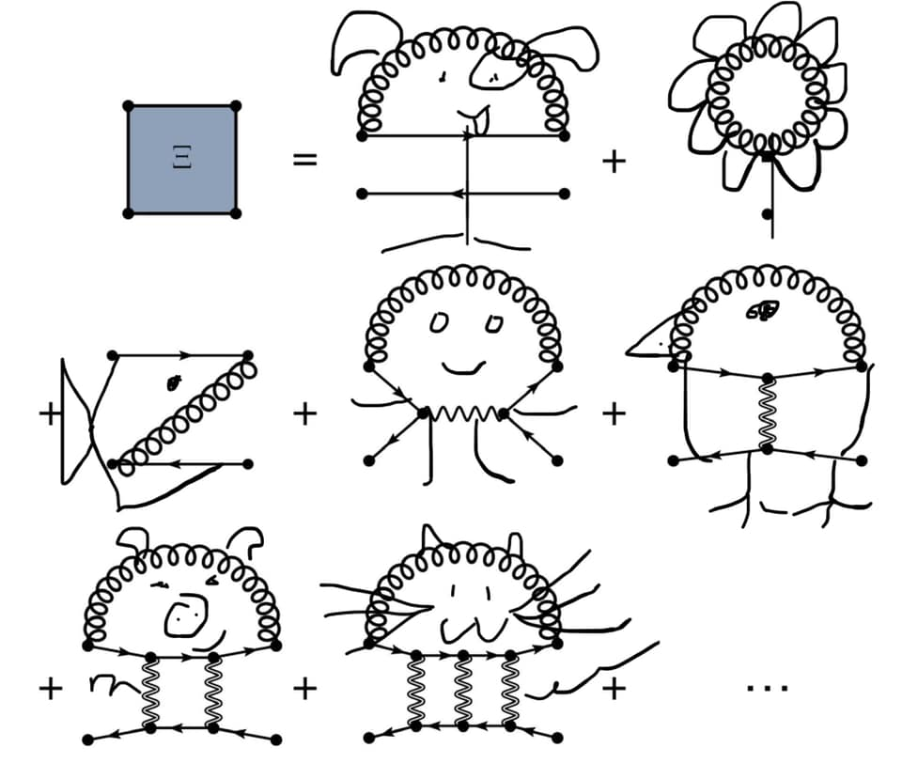




Exciton-phonon coupling
Claudio Attaccalite
CNRS/CINaM, Aix-Marseille Université(France)

Slide 2
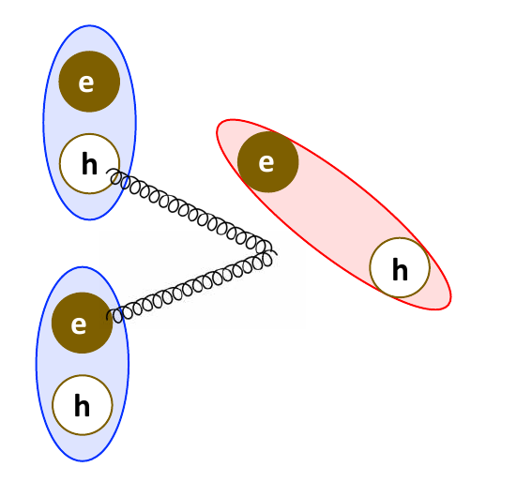
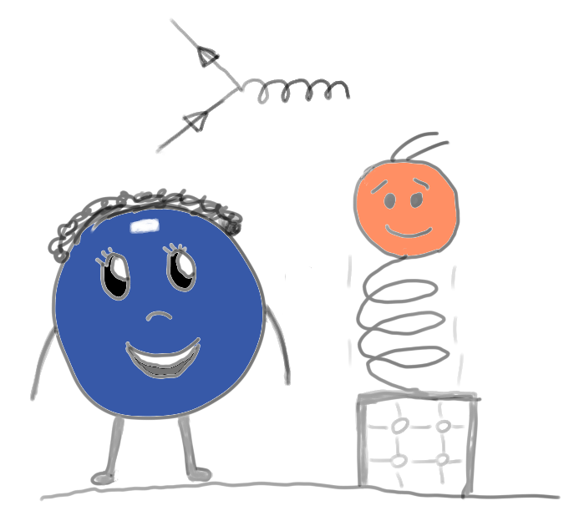
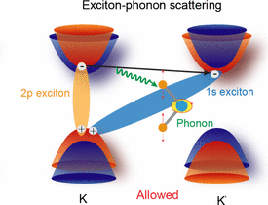
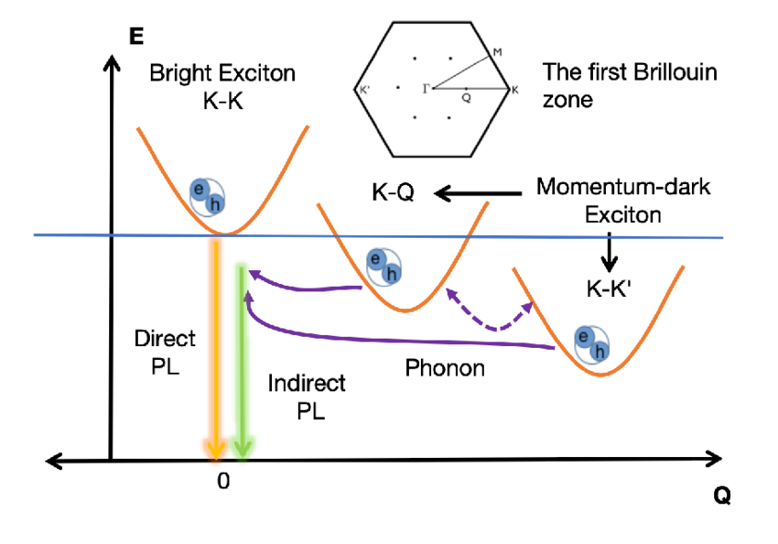
Outline:
1) Electron-phonon couping
2) Exciton-phonon coupling
and
Exciton-phonon Hamiltonian
3) Phonon assisted absorption/emission

Slide 3
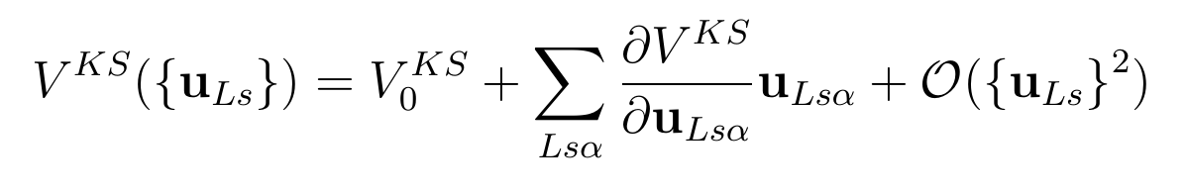
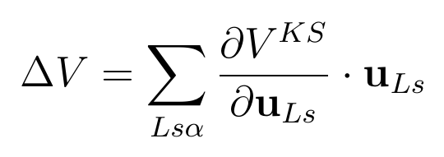
Electron-phonon
We expand the KS around the equilibrium positions :

Slide 4
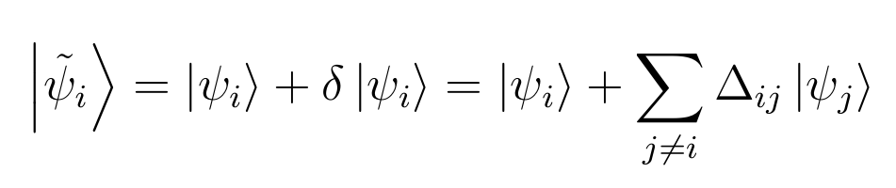
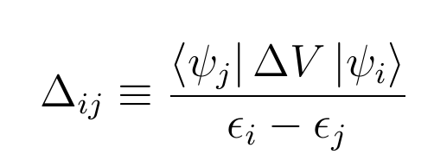
Electron-phonon
We expand the KS around the equilibrium positions :

Slide 5
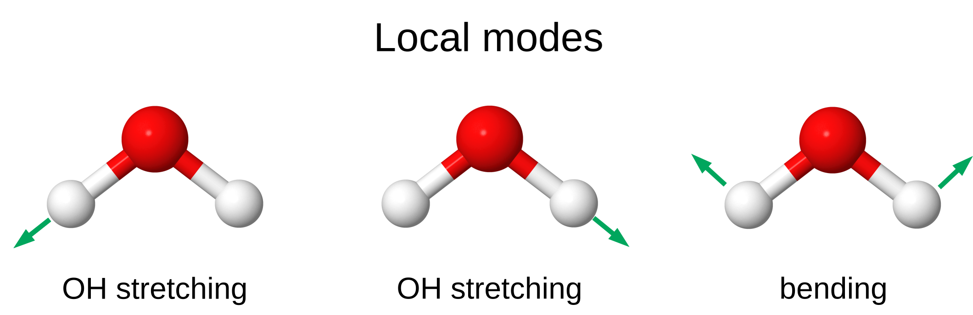
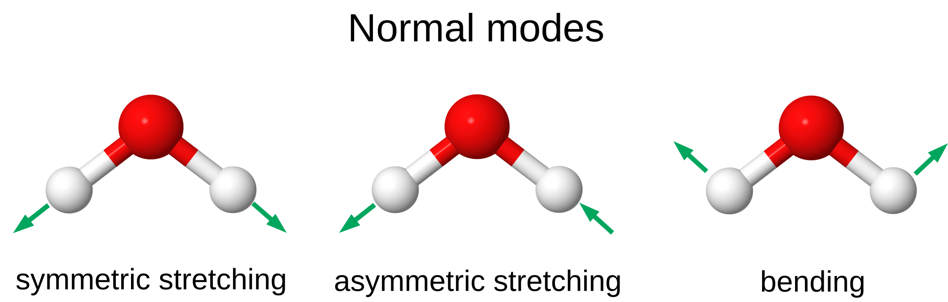
Electron-phonon
We rewrite everything from «local modes»
to «normal modes»

Slide 6
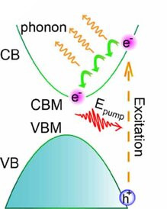
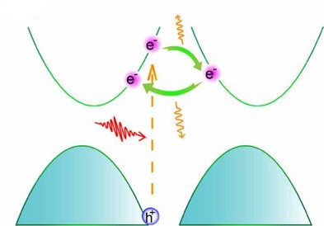
Electron-phonon
And Fourier transform (using the periodicity of V^{KS}) :
… now we can write the el-ph Hamiltonian as:

Slide 7

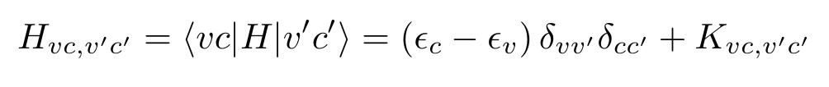

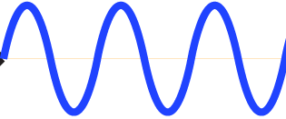

Bethe-Salpeter Hamiltonian
the BSE kernel
Derivative of Hartree
Derivative of
Screened-Exchange
=
+
-
Application of the Green’s functions method to the study of the optical properties of semiconductors.
Strinati G. La Rivista del Nuovo Cimento 11(12):1-86 (1988)

Slide 8
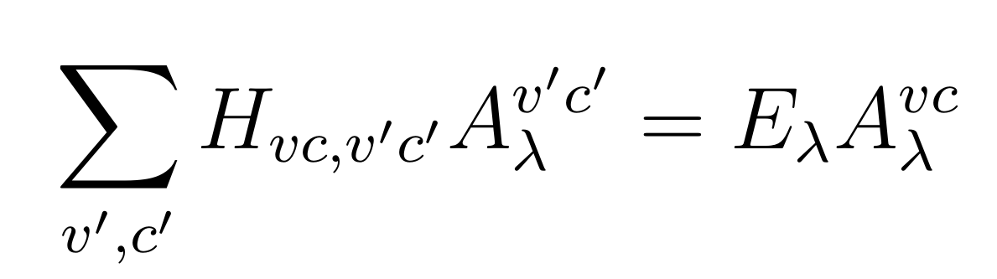
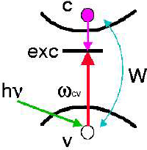
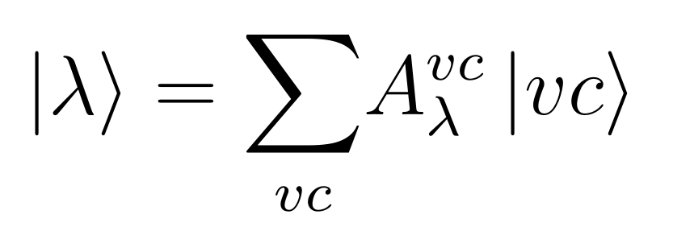
Bethe-Salpeter Hamiltonian

Slide 9
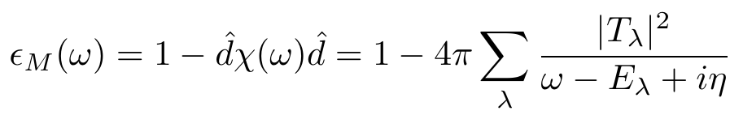
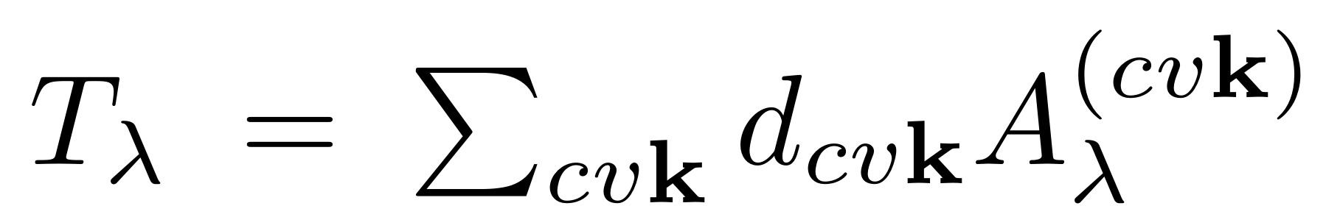
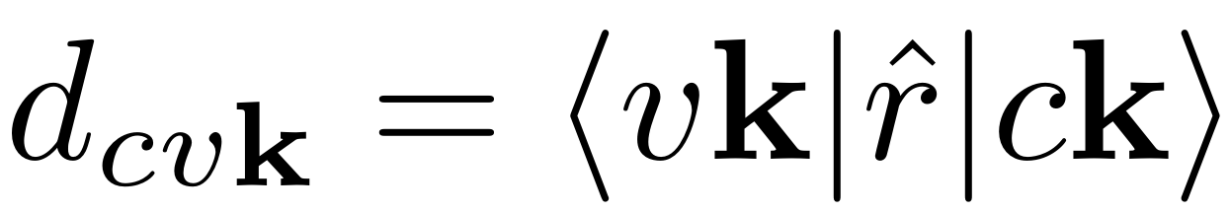
Bethe-Salpeter Hamiltonian
...from BSE solution to epsilon...

Slide 10
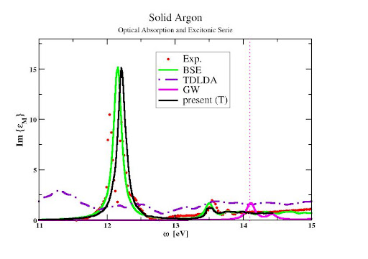
Bethe-Salpeter Hamiltonian
...from BSE solution to epsilon...

Slide 11
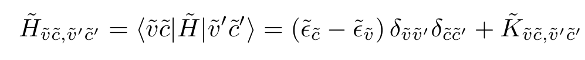
Exciton-phonon calculation
We build BSE from perturbed wave-functions
…. perturbed BSE at first order….
Exciton-phonon interaction and relaxation times from first principles.
Chen HY, Sangalli D, Bernardi M.
Physical Review Letters. 125, 107401 (2020)

Slide 12

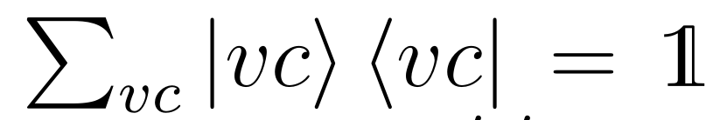
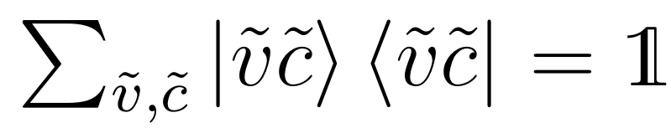
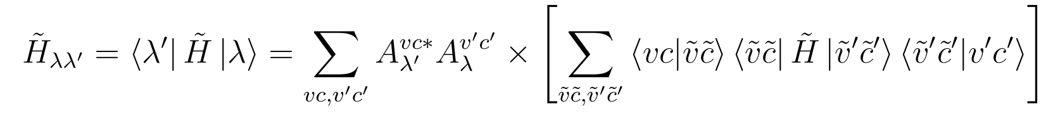
Exciton-phonon calculation
We use the solution of the unperturbed BSE to write ...
Using the identity:

Slide 13
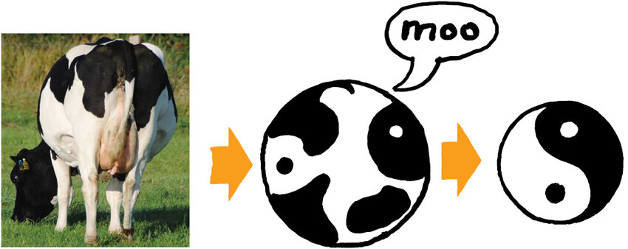



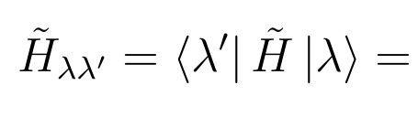
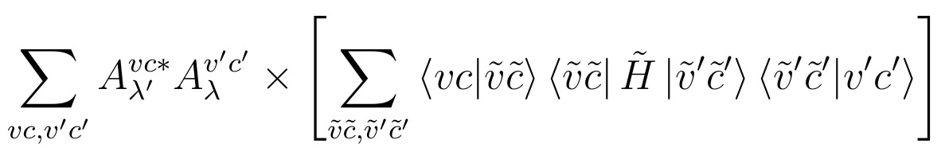
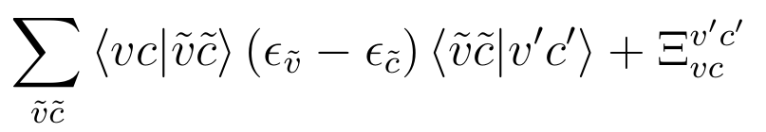
Approximations...
Accurate approximations to the GW self-energy electron-phonon coupling gradients
C. Faber, P. Boulanger, C. Attaccalite, I. Duchemin, E. Cannuccia, X. Blase
Phys. Rev. B, 91, 155109 (2015)

Slide 14

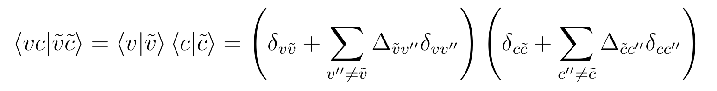
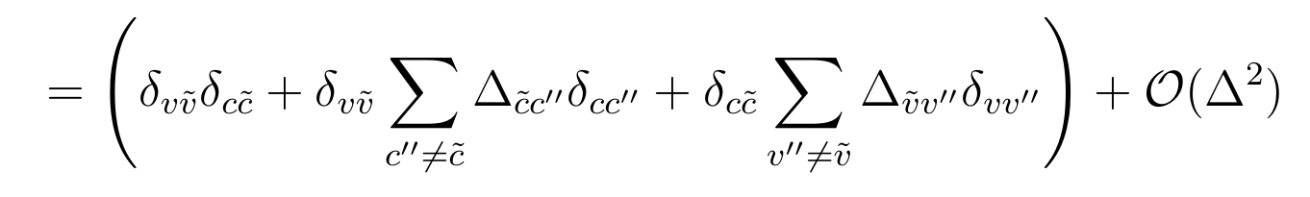
Approximations...
The only remaining contribution is from the variation of the wave-functions
Tamm-Dancoff approximation +

Slide 15

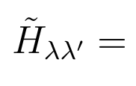
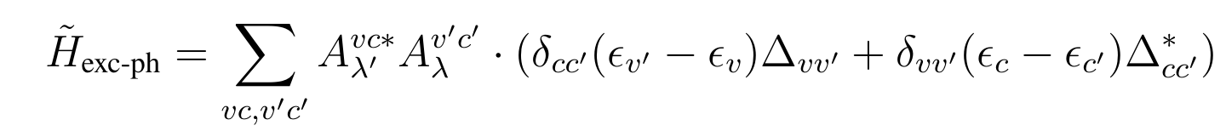
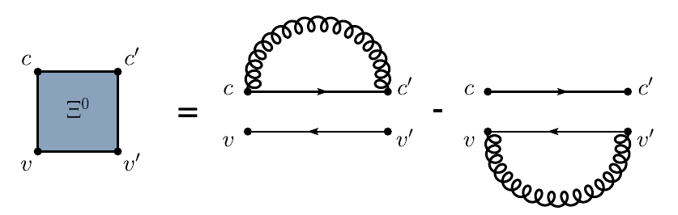
Doing some math….
The exciton-phonon interaction

Slide 16
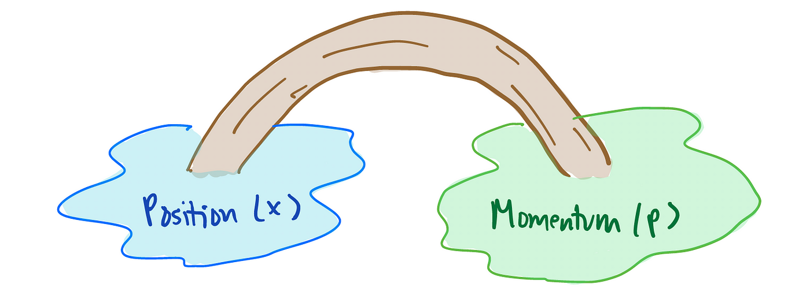
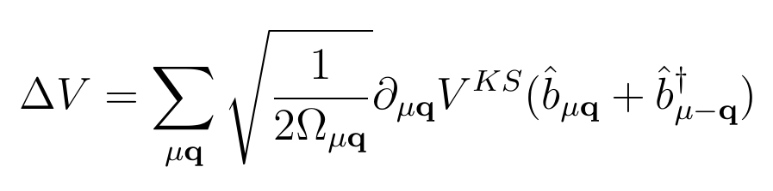

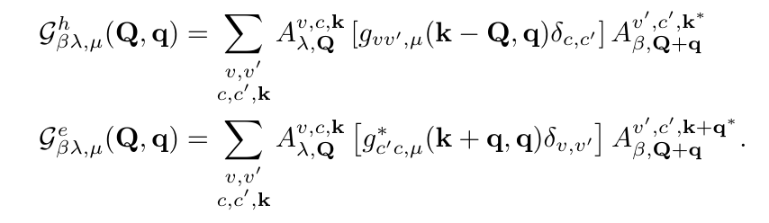
Exciton-phonon interaction

Slide 17
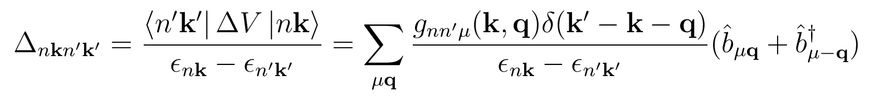
Exciton-phonon interaction

Slide 18
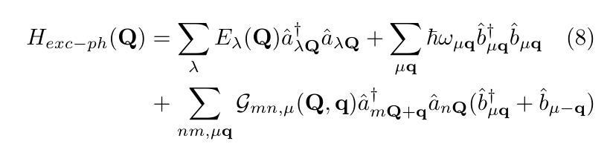
Exciton-phonon interaction
The Exc-ph Hamiltonian!!!

Slide 19

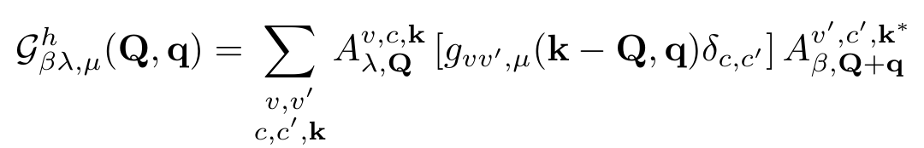
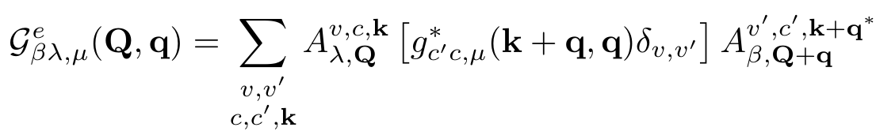
Exciton-phonon interaction

Slide 20
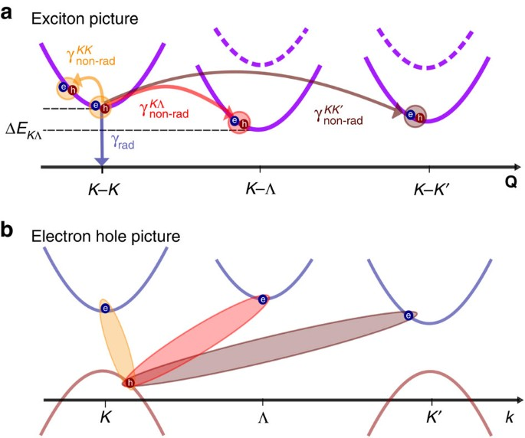
Exciton-phonon interaction

Slide 21
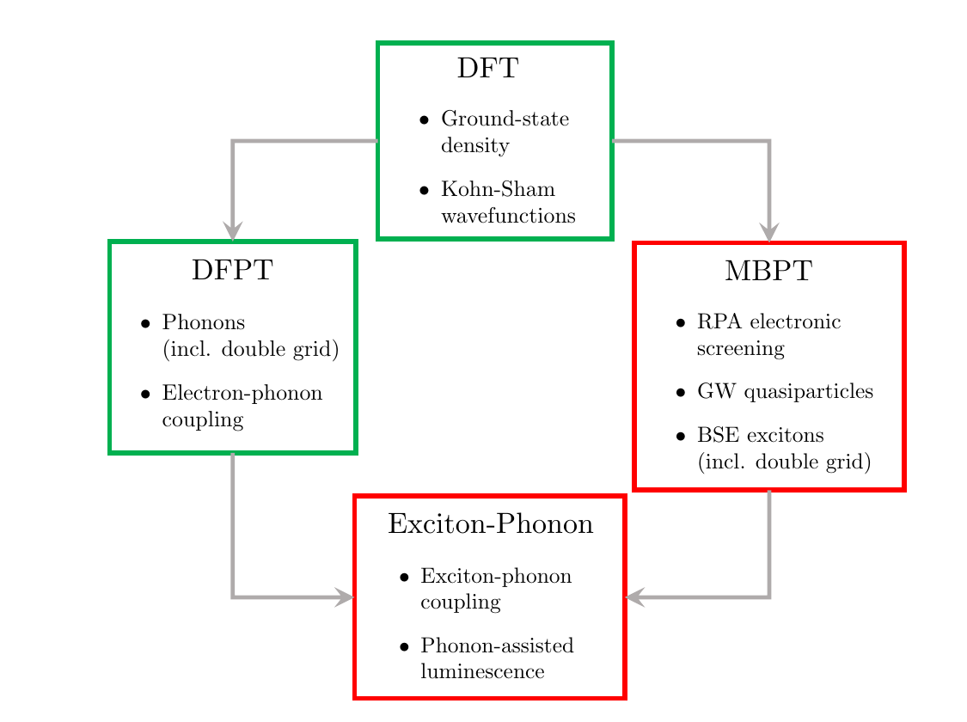
Exciton-phonon calculation

Slide 22

Solving the
Exciton-phonon Hamiltonian

Slide 23
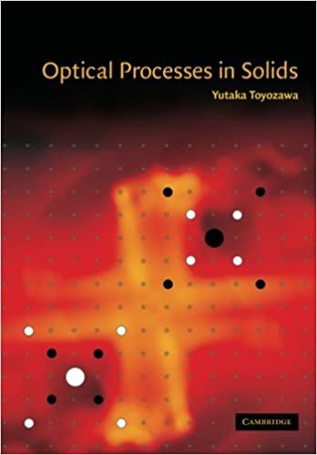
An old problem
extensively studied
by Toyozawa et al. In ‘50 and ‘60.

Slide 24

An old problem
extensively studied
by Toyozawa et al. In ‘50 and ‘60.
First solution of
dynamical Bethe-Salpeter equation.
The Shindo solution
J. Phys. Soc. Japan 29, 278 (1970)

Slide 25
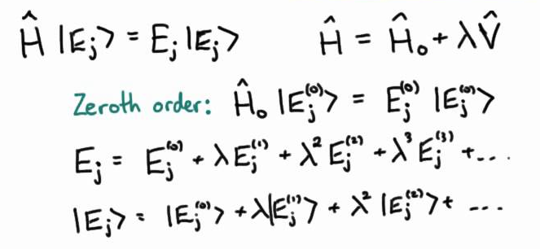
An old problem
extensively studied
by Toyozawa et al. In ‘50 and ‘60.
First solution of
dynamical Bethe-Salpeter equation.
The Shindo solution
J. Phys. Soc. Japan 29, 278 (1970)
Perturbative approach
V. Perebeinois, J. Tersoff, P. Avoris
PRL 94, 027402(2005)
Paleari PRL 122, 187401(2019)
Cannuccia PRB 99, 081109(2019)

Slide 26
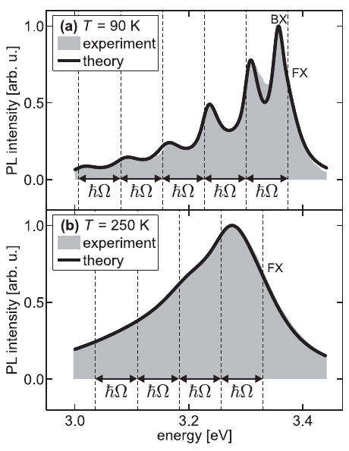
An old problem
extensively studied
by Toyozawa et al. In ‘50 and ‘60.
First solution of
dynamical Bethe-Salpeter equation.
The Shindo solution
J. Phys. Soc. Japan 29, 278 (1970)
Perturbative approach
V. Perebeinois, J. Tersoff, P. Avoris
PRL 94, 027402(2005)
Paleari PRL 122, 187401(2019)
Cannuccia PRB 99, 081109(2019)
Polaronic transformation
T. Feldtmann, M. Kira, and S. W. Koch
Phys. Stat. Solidi B 246, 332(2009)

Slide 27

An old problem
extensively studied
by Toyozawa et al. In ‘50 and ‘60.
First solution of
dynamical Bethe-Salpeter equation.
The Shindo solution
J. Phys. Soc. Japan 29, 278 (1970)
Perturbative approach
V. Perebeinois, J. Tersoff, P. Avoris
PRL 94, 027402(2005)
Paleari PRL 122, 187401(2019)
Cannuccia PRB 99, 081109(2019)
BSE + Cumulant
P. Cudazzo
PRB 102, 045136 (2020)
Polaronic transformation
T. Feldtmann, M. Kira, and S. W. Koch
Phys. Stat. Solidi B 246, 332(2009)

Slide 28
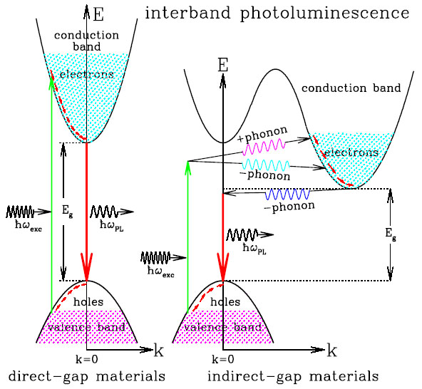
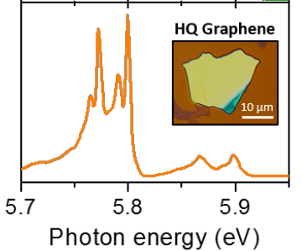
Phonon-assisted absorption/emission

Slide 29
Solving the
Exciton-phonon Hamiltonian

Slide 30
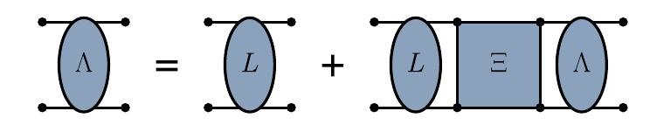




Phonon-assisted absorption/emission
Dyson equation in term of exc-ph self-energy
Exciton-phonon self-energy

Slide 31







Phonon-assisted absorption
Perturbative correction to epsilon at first order
“Direct” absorption
Phonon-assisted (“indirect”) absorption
Bare BSE
BSE+ Exc-ph H

Slide 32


Phonon-assisted absorption
“Direct” absorption
Phonon-assisted (“indirect”) absorption
Renormaliation factor
Satellites weight

Slide 33


Luminescence

Slide 34
Luminescence
Excitonic occupation

Slide 35

Luminescence
Excitonic occupation

Slide 36



Internal quantum yield
50%
0.1%
45%
ZnO
hBN
Diamond
Bright Luminescence from Indirect and Strongly Bound Excitons in h-BN
L. Schué, L. Sponza et al.,
Phys. Rev. Lett. 122, 067401(2019)

Slide 37


Conclusion and references
Electron-phonon interactions
from first principles
Feliciano Giustino
Rev. Mod. Phys. 89, 015003 (2017)
Theory of exciton-phonon coupling
G. Antonius and S. G. Louie
Phys. Rev. B 105, 085111(2022)
BSE + Cumulant
P. Cudazzo
PRB 102, 045136 (2020)
G. Marini, M. Calandra, and P. Cudazzo. Nano Letters 24, 6017(2024)
Polaronic transformation
T. Feldtmann, M. Kira, and S. W. Koch
Phys. Stat. Solidi B 246, 332(2009)
First-principles study of luminescence
Pierre Lechifflart, Fulvio Paleari, Davide Sangalli, and Claudio Attaccalite
Phys. Rev. Materials 7, 024006(2023)
Exciton-phonon coupling by finite differences
F. Paleari, H. PC Miranda H, A. Molina-Sánchez, L Wirtz Physical review letters. 2019 122,1874 (2019)
E. Cannuccia, B. Monserrat, C. Attaccalite
Physical Review B 99,081109 (2019)
Perturbative approach
V. Perebeinois, J. Tersoff, P. Avoris
PRL 94, 027402(2005)

